Slide 1
Reading Group Presentations Topic 1: Training set attack using machine teaching Yao Zhou Topic 2: Adversarial attack on graph embeddings
Jun Wu

Slide 2
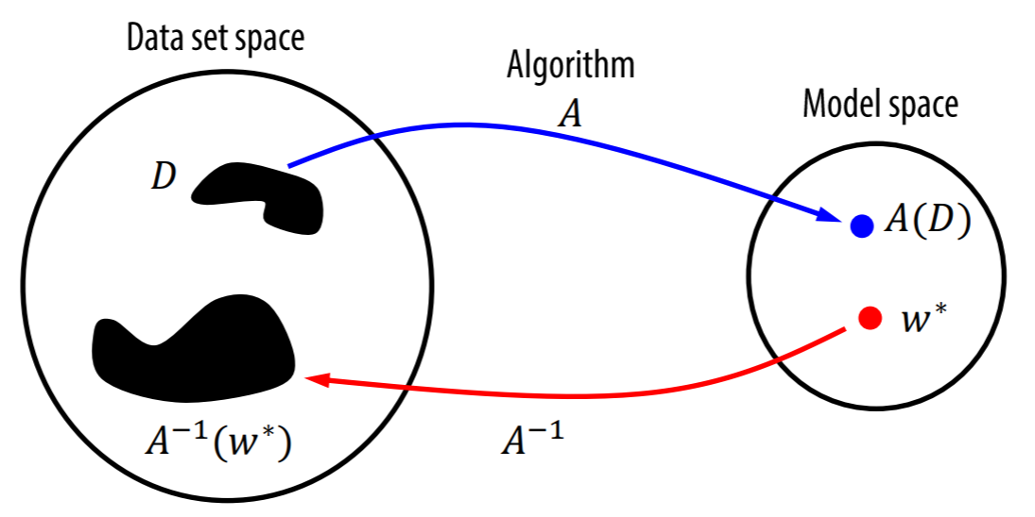
The Concept of Machine Teaching
Machine teaching – an inverse problem of machine learning
Machine Learning
W*: Target concept (e.g., a coefficient vector in Logistic Regression)
A: Learning algorithm (e.g., gradient descent)
D: Training set (e.g., examples)
Machine Teaching

Slide 3
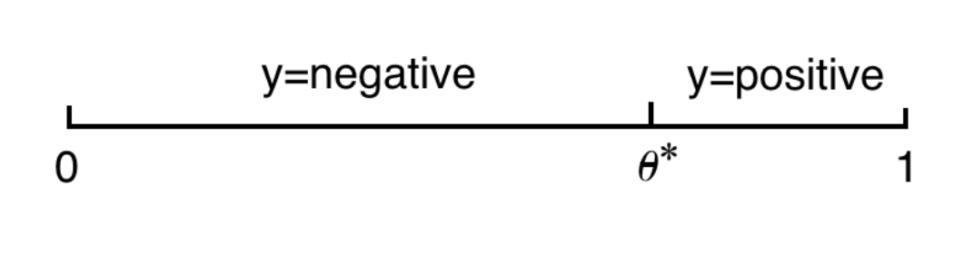
The Concept of Machine Teaching
A few demonstration examples
Consider learning a 1D threshold classifier.
Input is uniformly distributed on [0, 1].
The true threshold is θ*.

Slide 4
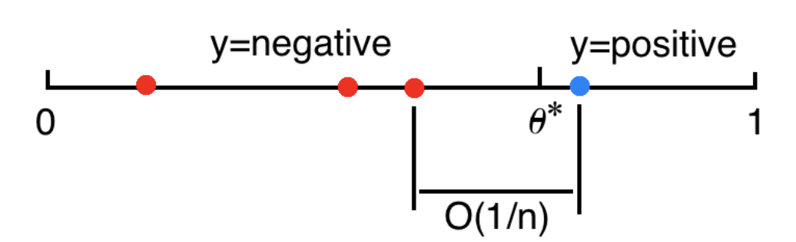
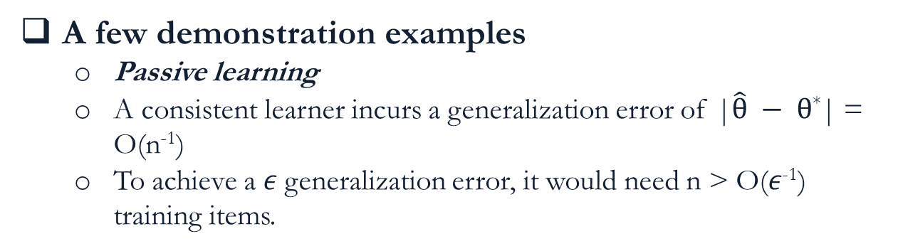
The Concept of Machine Teaching
A few demonstration examples
Passive learning
A consistent learner incurs a generalization error of |$\hat{θ} − θ$*| = O(n⁻¹)
To achieve a 𝜖 generalization error, it would need n > O(𝜖⁻¹) training items.
Notes:
Passive learning receives n training item. Intuitively with n uniform training items the average spacing is 1/n which is the uncertainty of the decision boundary.

Slide 5
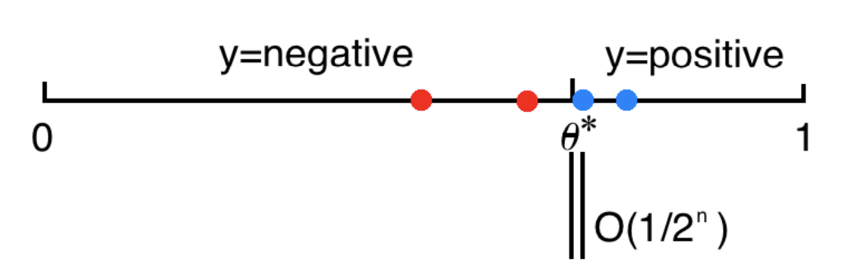
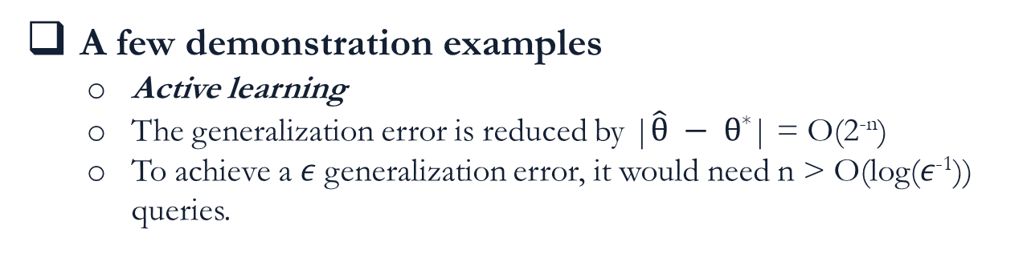
The Concept of Machine Teaching
A few demonstration examples
Active learning
The generalization error is reduced by |$\hat{θ} − θ$*| = O(2^{-n})
To achieve a 𝜖 generalization error, it would need n > O(log(𝜖⁻¹)) queries.

Slide 6
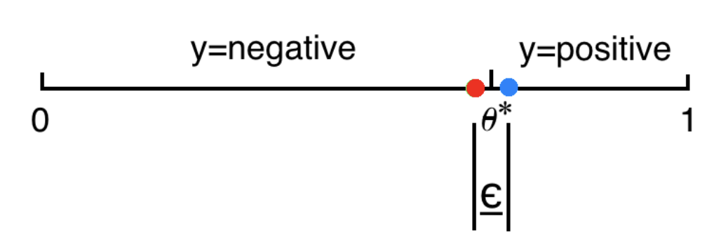
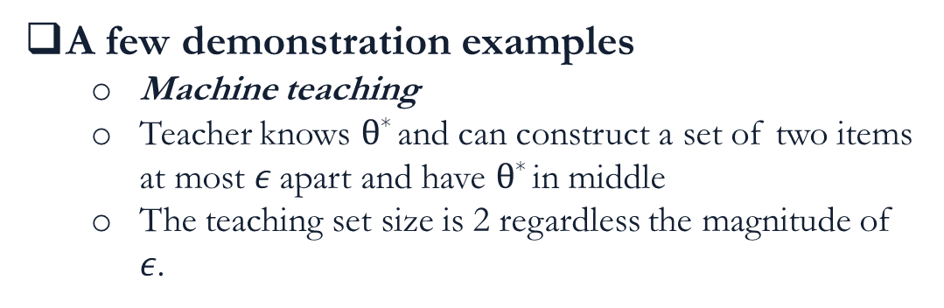
The Concept of Machine Teaching
A few demonstration examples
Machine teaching
Teacher knows $θ$* and can construct a set of two items at most 𝜖 apart and have $θ$* in middle
The teaching set size is 2 regardless the magnitude of 𝜖.

Slide 7
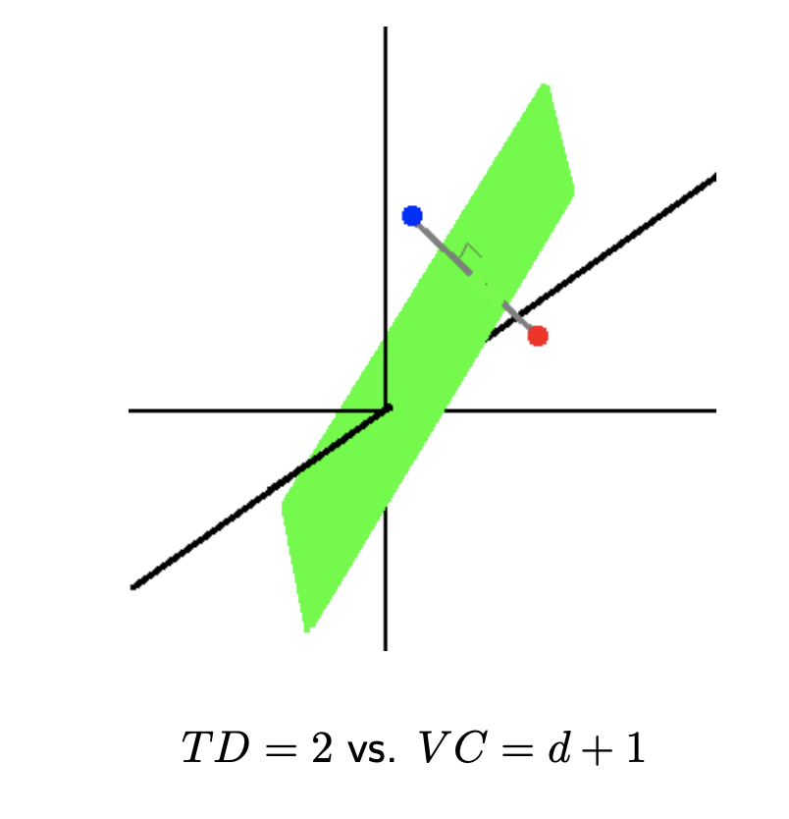
The Concept of Machine Teaching
Another example: teaching hard margin SVM
Teaching dimension: the smallest teaching set size of this teaching task TD = 2
Notes:
Let us look at a second example, where the teacher teaches a hard-margin SVM a target hyperplane decision boundary in d-dimensional space.
It turns out the teacher can construct a teaching set consisting of two d-dimensional points. In fact there are infinitely many such teaching 2 sets, as long as the line segment between the two points is bisected by, and perpendicular to, the target hyperplane:

Slide 8
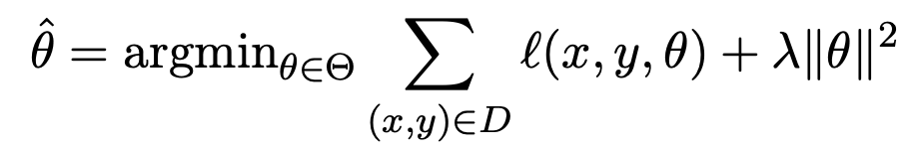
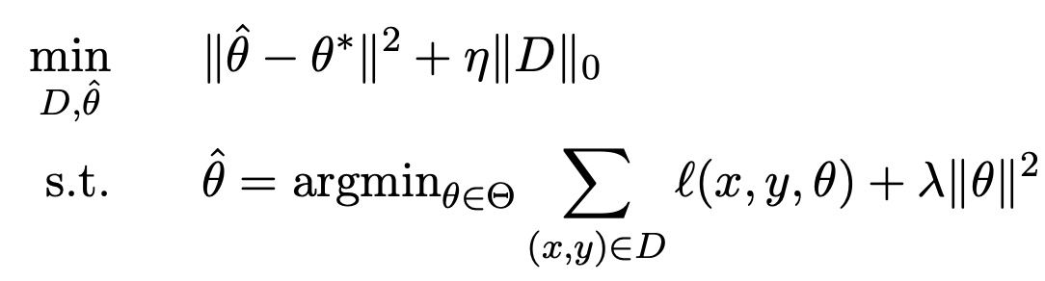
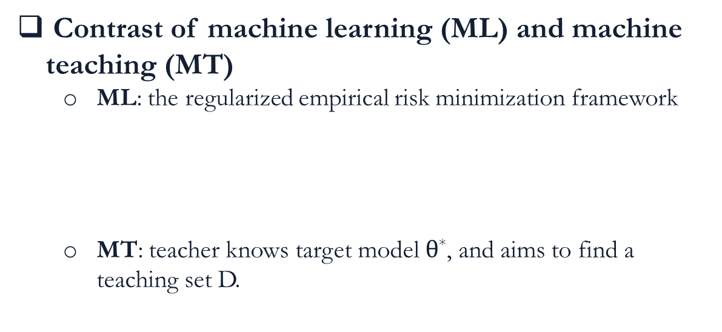
The Concept of Machine Teaching
Contrast of machine learning (ML) and machine teaching (MT)
ML: the regularized empirical risk minimization framework
MT: teacher knows target model $θ$*, and aims to find a teaching set D.

Slide 9
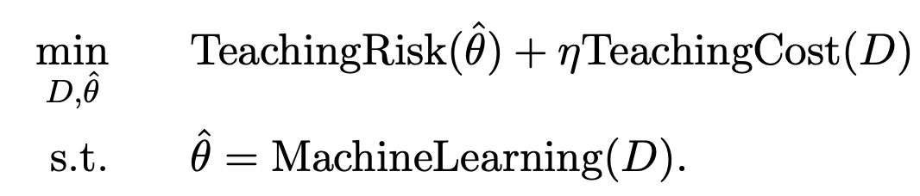
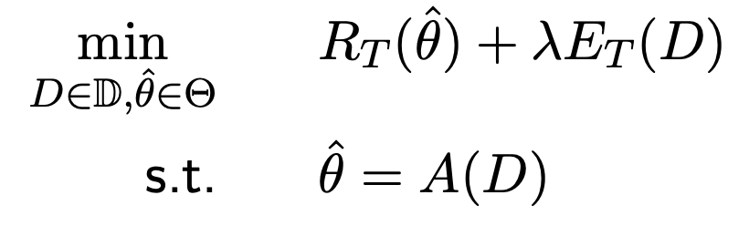
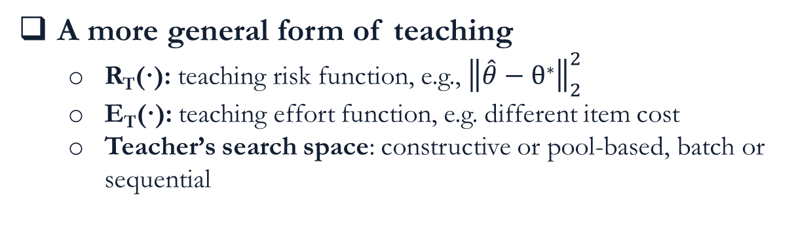
The Concept of Machine Teaching
A more general form of teaching
R_{T}(·): teaching risk function, e.g., ${\left\|\hat{θ}−θ\text{∗}\right\|}_{2}^{2}$
E_{T}(·): teaching effort function, e.g. different item cost
Teacher’s search space: constructive or pool-based, batch or sequential
Notes:
Teaching risk: measure how unsatisfied the teacher is.
Teaching cost(effort): a simple definition could be the number of items in this teaching set.

Slide 10
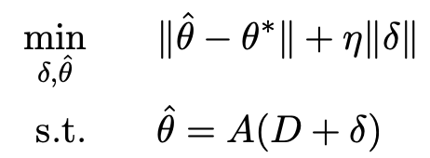
The Concept of Machine Teaching
Characterize the machine teaching space (teacher T teaches student S)
T=machine, S=machine: E.g., data poisoning attacks.
T=machine, S=human: E.g., computer tutoring system, where the key is to assume a cognitive model A of the human learner.
T=human, S=machine: E.g., human-in-the-loop intervention of fast training a text classifier. For a 1D threshold classifier, human can produce an optimal teaching set.
T=human, S=human: E.g. the traditional education in real life..
Data Attack!
Crowd Teaching!

Slide 11
Using Machine Teaching to Attack Training Set
Quick overview of the framework
Assumption: Attacker has full knowledge of the learning algorithm
Target: Poison the training set in order to mislead the learner to a specific wrong models
Approach: Bi-level optimization
Solution: Covert the bi-level optimization to a single level optimization problem using KKT condition
Instantiations: SVM, Logistic Regression, Linear Regression

Slide 12
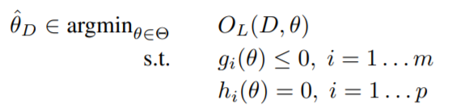
Using Machine Teaching to Attack Training Set
Preliminary
Machine learner:
The learner has a regularized risk minimization objective:
The attacker (teacher) want to manipulate the original training data D_{0,} by changing existing items (x, y) to be (x’, y) or (x, y’) to get D.

Slide 13
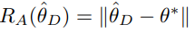
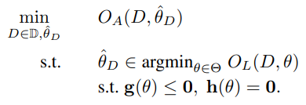
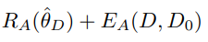
Using Machine Teaching to Attack Training Set
Preliminary
Attacker’s risk function:
Attacker’s effort function:
Attacker’s overall objective:
upper-level problem
lower-level problem

Slide 14
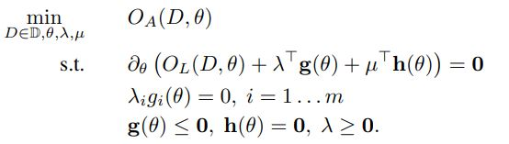
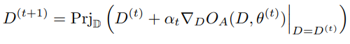
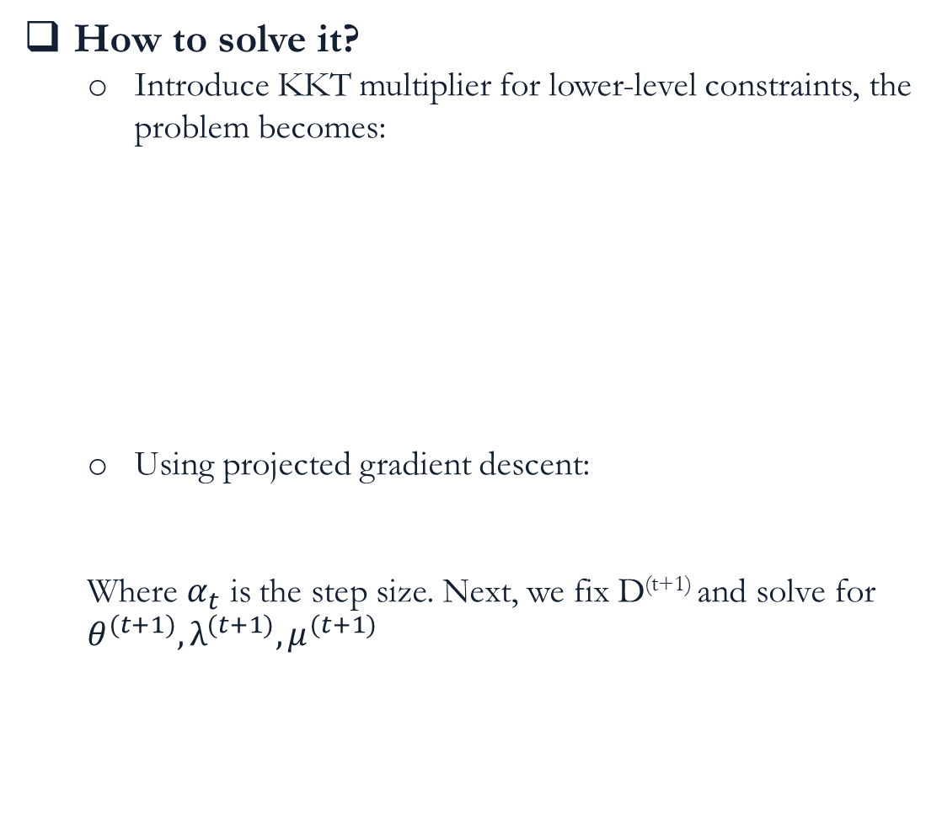
Using Machine Teaching to Attack Training Set
How to solve it?
Introduce KKT multiplier for lower-level constraints, the problem becomes:
Using projected gradient descent:
Where $α_{t}$ is the step size. Next, we fix D^{(t+1)} and solve for $θ^{(t+1)}, λ^{(t+1)}, μ^{(t+1)}$
Complementary slackness
Primal feasibility
Dual feasibility

Slide 15
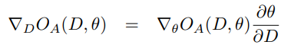
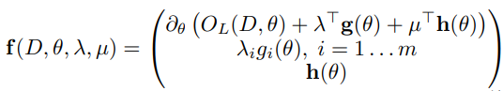
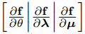
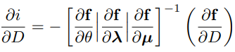
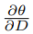
Using Machine Teaching to Attack Training Set
What’s the issue?
The gradient of the upper problem is:
Use the implicit function theorem (IFT) to help.
Equalities in KKT can introduce a function f:
The following solution is induced (if f is differentiable w.r.t. its parameters and its Jacobian matrix is full-rank) by defining
Then, is the first d rows of
A Jacobian matrix of size d x n, which does not have an explicit expression

Slide 16
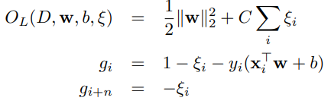
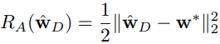
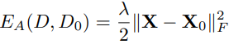
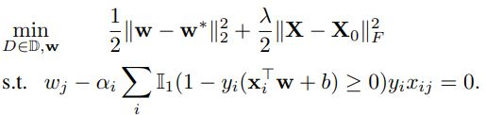
Using Machine Teaching to Attack Training Set
Attacking SVM
Original data set:
Attack search space:
Learner (lower-level problem):
Attacker risk function and effort function are:
Overall attack problem:

Slide 17
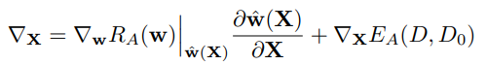
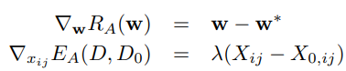
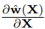
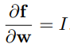
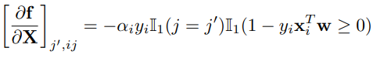
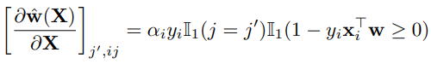
Using Machine Teaching to Attack Training Set
Attacking SVM
Gradient calculation:
Risk gradient and effort gradient are:
To calculate , the Jacobian matrix is:
The Jacobian at row j’ and column ij is:
The element at row j’ and column ij in is:
Modifying point x has effect on w only if x has incurred the hinge loss (i.e., x is a support vector)

Slide 18
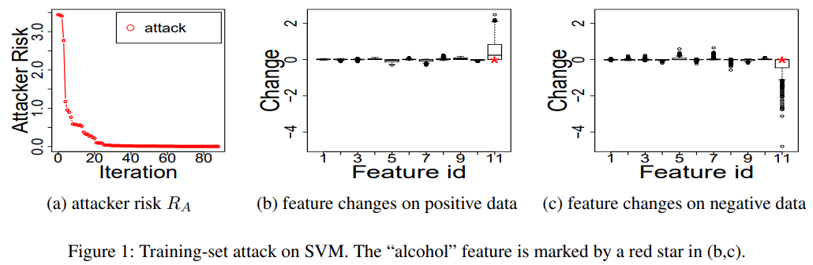
Using Machine Teaching to Attack Training Set
Attacking SVM
Experiments setting: n = 1600, d – 11, binary classification of wine quality (y).
Attacker goal: make it looks like only the feature ‘alcohol’ correlates with wine quality.
How to generate the target weight vector w*? Create another set of labels y’ for each data point in D₀, by threshold the feature ‘alcohol’ > 0, and then learn the w*.

Slide 19
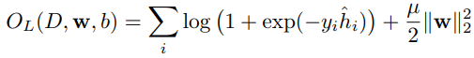
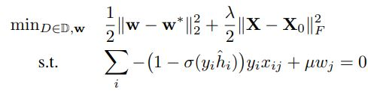
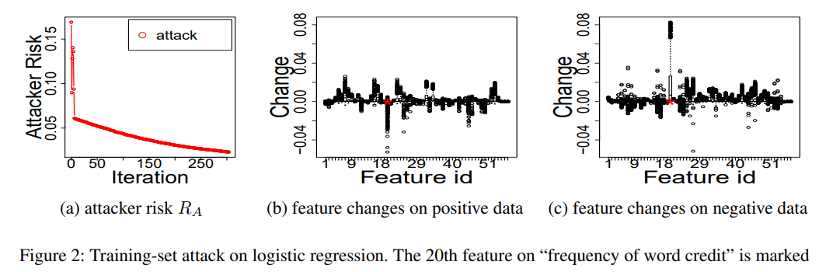
Using Machine Teaching to Attack Training Set
Attacking Logistic Regression
Original data set:
Attack search space:
Learner (lower-level problem):
Overall attack problem:

Slide 20
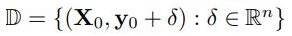
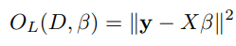
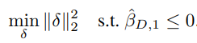
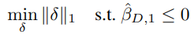
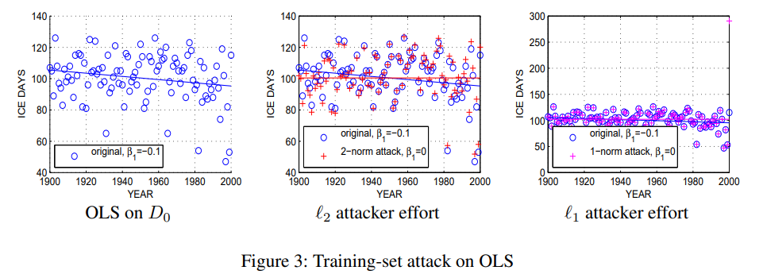
Using Machine Teaching to Attack Training Set
Attacking Linear Regression
Original data set:
Attack search space:
Learner (lower-level problem):
Overall attack problem:

Slide 21
Adversarial Attacks on Graph Embedding
Presented by Jun Wu
Email: junwu3@illinois.edu
Part of slides adapted from Aleksandar Bojchevski & Stephan Günnemann:
https://icml.cc/media/Slides/icml/2019/grandball(11-11-00)-11-11-00-4730-adversarial_att.pdf

Slide 22
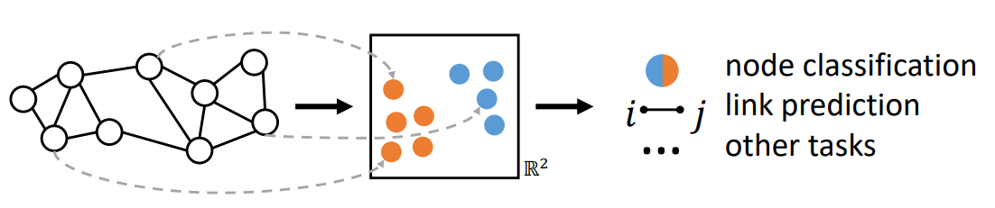
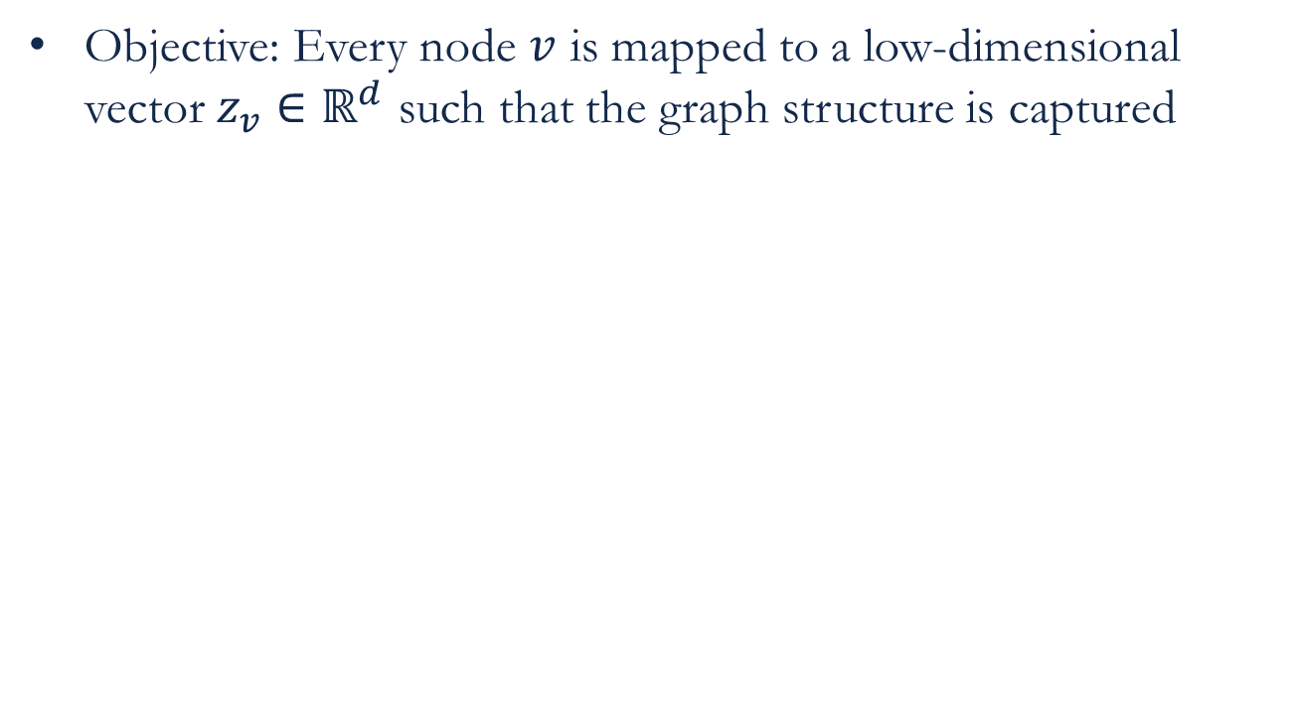
Background: Node Embedding
Objective: Every node $v$ is mapped to a low-dimensional vector $z_{v}∈ℝ^{d}$ such that the graph structure is captured
Similar nodes are close to each other in the embedding space.
Notes:
Similar nodes are close to each other in the embedding space
It could be used to many downstream graph mining tasks: node classification, node clustering, link prediction, etc.

Slide 23
Background: Node Embedding
 | Random Walk Based | Graph Convolution Based
Input | Plain network without node features | Attributed network with node features
Output | Node embeddings (unsupervised) | Node embedding Predictive node class-label (semi-supervised)
Assumption | Nearby nodes share the similar embeddings | Nearby nodes share the similar embeddings
Key idea | Maximize the likelihood of positive node-context pairs sampled by (biased) random walk | Recursively aggregate node messages along edges of the graph
Attacks | Aleksandar Bojchevski, and Stephan Günnemann. "Adversarial attacks on node embeddings via graph poisoning." In ICML 2019. | Daniel Zügner, and Stephan Günnemann. "Adversarial attacks on graph neural networks via meta learning." ICLR 2019.

Slide 24
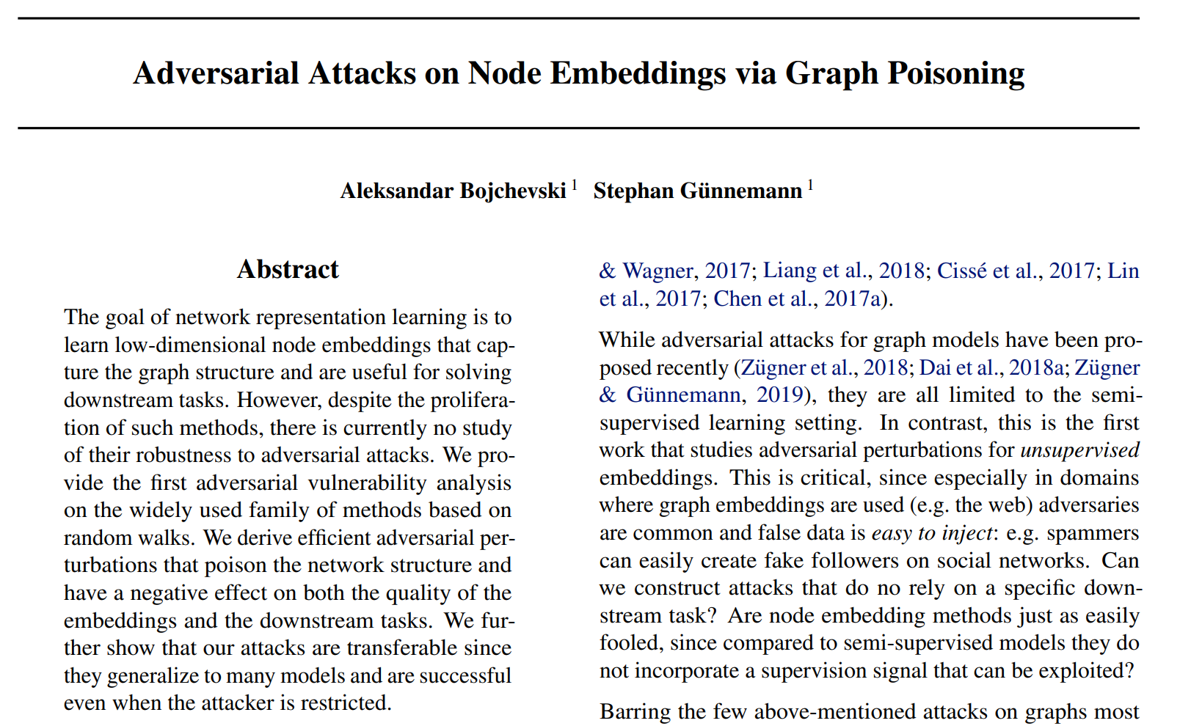
Random Walk Based Embedding

Slide 25

Random Walk Based Embedding
It is close to train a language model, e.g., word2vec
Nodes = words
(Biased) random walks = sentences
Nodes that co-occur in the random-walks have similar embeddings.
Skip-gram with negative sampling: use the current node to predict its context, while node-context pairs are extracted by random walk
For example: DeepWalk, node2vec, etc.
Bryan Perozzi, Rami Al-Rfou, and Steven Skiena. "DeepWalk: Online learning of social representations." In Proceedings of the 20th ACM SIGKDD international conference on Knowledge discovery and data mining, pp. 701-710. ACM, 2014.
Grover, Aditya, and Jure Leskovec. "node2vec: Scalable feature learning for networks." In Proceedings of the 22nd ACM SIGKDD international conference on Knowledge discovery and data mining, pp. 855-864. ACM, 2016.

Slide 26

Are node embeddings robust to adversarial attacks?
Plain network (undirected, unweighted network)
Graph structure attack: add/remove edges (limited budget)
Questions:
Q1: How is the overall embedding quality affected by adversarial attack?
Q2: How do these attacks affect the downstream tasks?

Slide 27



Poisoning attack
Notation:
$G=(V,E)$: input network
$A∈{\left\{0,1\right\}}^{N×N}$: adjacent matrix
$A′∈{\left\{0,1\right\}}^{N×N}$: poisoned adjacent matrix
$Z∈ℝ^{N×K}$: node embedding
$z_{v}∈ℝ^{K}$: node embedding of node $v$
$RW(A)$: random walk sentences from $G$
Objective: attack the node embedding quality
The quality of node embedding is measured by the loss function of the model $ℒ\left(A,Z\right)$
E.g., the loss function of DeepWalk is
$$ℒ\left(A,Z\right)=−\log{Pr\left(z_{v}|z_{u}\right)}, \left(u,v\right)\sim RW\left(A\right)$$
Bi-level optimization problem
The graph after perturbing some edges
$${A^{′}}^{∗}=\arg{\max_{A^{′}∈{\left\{0,1\right\}}^{N×N}}{ℒ\left(A^{′},Z^{∗}\right), Z^{∗}=\arg{\min_{Z}{ℒ\left(A^{′},Z\right)}}}}$$
$$s.t. {\left\|A^{′}−A\right\|}_{0}=2f, A^{′T}=A′$$
Constraint: fixed number of flips (user-defined $f$)
The optimal embedding from the graph $A′$

Slide 28


Challenges
Notation:
$G=(V,E)$: input network
$A∈{\left\{0,1\right\}}^{N×N}$: adjacent matrix
$A^{′}∈{\left\{0,1\right\}}^{N×N}$: poisoned adjacent matrix
$Z∈ℝ^{N×K}$: node embedding
$z_{v}∈ℝ^{K}$: node embedding of node $v$
$RW(A)$: random walk sentences from $G$
The loss function of DeepWalk
$${A′}^{∗}=\arg{\max_{\begin{aligned}A^{′}∈{\left\{0,1\right\}}^{N×N} \\ \begin{aligned}{\left\|A^{′}−A\right\|}_{0}=2f, \\ {A^{′}}^{T}=A^{′}\end{aligned}\end{aligned}}{\min_{Z}{ℒ\left(RW\left(A^{′}\right),Z\right)}}}$$
C1: Combinatorial search space.
C2: Bi-level optimization problem.
C3: Inner optimization includes non-differentiable sampling.

Slide 29

Solutions
Reduce the bi-level problem to a single-level problem (Target C2 & C3)
DeepWalk as matrix factorization
Express the optimal via the graph spectrum
Approximate the poisoned graph’s spectrum (Target C1)

Slide 30


Reduce bi-level problem to a single-level
DeepWalk corresponds to factorizing the PPMI (Positive Pointwise Mutual Information) matrix.
Embedding dimensionality
Optimal embedding
Notation:
$G=(V,E)$: input network
$A∈{\left\{0,1\right\}}^{N×N}$: adjacent matrix
$\hat{M}$: PPMI matrix induced by $A$
$D$: diagonal degree matrix $D_{ii}=\sum_{j}{A_{ij}}$
$vol\left(A\right)$: volume $vol\left(A\right)=\sum_{ij}{A_{ij}}$
$Z∈ℝ^{N×K}$: node embedding
$T$: length of random walk sentences
$b$: number of negative samples
Hyperparameters in DeepWalk
Jiezhong Qiu, Yuxiao Dong, Hao Ma, Jian Li, Kuansan Wang, and Jie Tang. "Network embedding as matrix factorization: Unifying DeepWalk, line, PTE, and node2vec." In Proceedings of the Eleventh ACM International Conference on Web Search and Data Mining, pp. 459-467. ACM, 2018.

Slide 31




Reduce bi-level problem to a single-level
Express the optimal $ℒ\left(A,Z^{∗}\right)$ via the graph spectrum
$$ℒ_{DW1}\left(A,Z^{∗}\right)={\left\|\hat{M}−{\hat{M}}_{K}\right\|}_{F}={\left[\sum_{p=K+1}^{N}{σ_{p}^{2}}\right]}^{1/2}$$
No need to construct random walks
No need to compute the optimal embeddings explicitly
$${A^{′}}^{∗}=\arg{\max_{\begin{aligned}A^{′}∈{\left\{0,1\right\}}^{N×N} \\ \begin{aligned}{\left\|A^{′}−A\right\|}_{0}=2f, \\ {A^{′}}^{T}=A^{′}\end{aligned}\end{aligned}}{{\left[\sum_{p=K+1}^{N}{σ_{p}^{2}}\right]}^{1/2}}}$$
$$A^{′∗}=\arg{\max_{\begin{aligned}A^{′}∈{\left\{0,1\right\}}^{N×N} \\ \begin{aligned}{\left\|A^{′}−A\right\|}_{0}=2f, \\ {A^{′}}^{T}=A^{′}\end{aligned}\end{aligned}}{\min_{Z}{ℒ\left(RW\left(A′\right),Z\right)}}}$$
Bi-level optimization problem
Single-level optimization problem
Notation:
$A∈{\left\{0,1\right\}}^{N×N}$: adjacent matrix
$A^{′}∈{\left\{0,1\right\}}^{N×N}$: poisoned adjacent matrix
$\hat{M}$: PPMI matrix induced by $A$
${\hat{M}}_{K}=U_{K}Σ_{K}V_{K}$: best rank-K approximation to $\hat{M}$
$σ_{p}$: p-th singular value of $\hat{M}$ sorted decreasingly $σ_{1}≥σ_{2}≥⋯≥σ_{N}$

Slide 32

Challenges
Notation:
$G=(V,E)$: input network
$A∈{\left\{0,1\right\}}^{N×N}$: adjacent matrix
$A^{′}∈{\left\{0,1\right\}}^{N×N}$: poisoned adjacent matrix
$Z∈ℝ^{N×K}$: node embedding
$z_{v}∈ℝ^{K}$: node embedding of node $v$
$RW(A)$: random walk sentences from $G$
The loss function of DeepWalk
$${A′}^{∗}=\arg{\max_{\begin{aligned}A^{′}∈{\left\{0,1\right\}}^{N×N} \\ \begin{aligned}{\left\|A^{′}−A\right\|}_{0}=2f, \\ {A^{′}}^{T}=A^{′}\end{aligned}\end{aligned}}{\min_{Z}{ℒ\left(RW\left(A^{′}\right),Z\right)}}}$$
C1: Combinatorial search space.
C2: Bi-level optimization problem.
C3: Inner optimization includes non-differentiable sampling.

Slide 33


Single-level optimization
Objective: attack the node embedding quality
The quality of node embedding is measured by the loss function of the model $ℒ_{DW1}\left(A′,Z^{∗}\right)$
Optimization
Gradient-based optimization: discrete solution space
$${A′}_{k+1}←{A′}_{k}−α∇_{A^{′}}ℒ_{DW1}\left(A′,Z^{∗}\right)$$
Brute-force search: extremely time-consuming
$${A′}^{∗}=\arg{\max_{\begin{aligned}A^{′}∈{\left\{0,1\right\}}^{N×N} \\ \begin{aligned}{\left\|A^{′}−A\right\|}_{0}=2f, \\ {A^{′}}^{T}=A^{′}\end{aligned}\end{aligned}}{{\left[\sum_{p=K+1}^{N}{σ_{p}^{2}}\right]}^{1/2}}}$$

Slide 34



Gradient-based Approach
Problem: cannot easily backpropagate through the SVD
$$ℒ_{DW1}\left(A′ \right)={\left\|\hat{M}′−{\hat{M}′}_{K}\right\|}_{F}^{2}={\left[\sum_{p=K+1}^{N}{σ_{p}^{2}}\right]}^{1/2}$$
Solution: approximate $ℒ_{DW1}\left(A′,Z^{∗}\right)$ without needing to recompute the SVD
Alternative loss function
$$ℒ_{DW2}\left(A′ \right)=\sum_{p=K+1}^{N}{{\left(u_{p}^{T}\left(\hat{M}+Δ\hat{M}\right)u_{p}\right)}^{1/2}}$$
Approximation:
$$\left|ℒ_{DW1}\left(A′ \right)−ℒ_{DW2}\left(A′ \right)\right|≤{\left\|Δ\hat{M}\right\|}_{F}$$
SVD on $\hat{M}′$
Notation:
$A∈{\left\{0,1\right\}}^{N×N}$: adjacent matrix
$A^{′}∈{\left\{0,1\right\}}^{N×N}$: poisoned adjacent matrix
$\hat{M}$: PPMI matrix induced by $A$
${\hat{M}}^{′}=\hat{M}+Δ\hat{M}$: perturbed PPMI matrix induced by perturbed matrix $A′$
$u_{p}$: p-th eigen-vector corresponding to p-th largest eigen-value of $\hat{M}$

Slide 35


Gradient-based Approach
Loss function:
$$ℒ_{DW2}\left(A′ \right)=\sum_{p=K+1}^{N}{{\left(u_{p}^{T}{\hat{M}′u}_{p}\right)}^{1/2}}$$
It is efficient to compute
$$∇_{A^{′}}ℒ_{DW2}\left(A′ \right)=∇_{{\hat{M}}^{′}}\sum_{p=K+1}^{N}{{\left(u_{p}^{T}{\hat{M}′u}_{p}\right)}^{1/2}}∙∇_{A^{′}}\hat{M}′$$
Greedy search using the gradient
Large gradient of entry on $A^{′}$ implies large permutation to the loss function
Greedily choose the best flip
solution
$$\begin{aligned}A^{′}∈{\left\{0,1\right\}}^{N×N} \\ \begin{aligned}{\left\|A^{′}−A\right\|}_{0}=2f, \\ {A^{′}}^{T}=A^{′}\end{aligned}\end{aligned}$$
challenge
C1: Combinatorial search space.

Slide 36






Closed-form Approach (Brute-force)
Choose a candidate set
All the real edges
Randomly sampling C candidate pairs (non-edges)
Greedily search the optimal edge flip
Compute the loss value when one flip happened
Choose the edge flip with the largest loss value
Approximate the poisoned graph’s spectrum
approximation
$\frac{N^{2}−N}{2}$ possible flips
approximation
$$ℒ_{DW3}\left(A′\right)=\frac{vol\left(A\right)+2Δw_{ij}}{T∙b}{\left[\sum_{p=K+1}^{N}{\left(\frac{1}{d_{min}^{′}}∙\left|\sum_{r=1}^{T}{{\left(λ_{p}^{′}\right)}^{r}}\right|\right)}\right]}^{1/2}$$
Compute in $O(1)$
$$λ_{p}^{′}=λ_{p}+Δλ_{p}$$
$$Δλ_{p}≈Δw_{ij}\left(2u_{pi}∙u_{pj}−λ_{p}\left(u_{pi}^{2}+u_{pj}^{2}\right)\right)$$
Notation:
$A^{′}∈{\left\{0,1\right\}}^{N×N}$: poisoned adjacent matrix
$vol\left(A\right)$: volume $vol\left(A\right)=\sum_{ij}{A_{ij}}$
$T$: length of random walk sentences
$b$: number of negative samples
$d_{min}^{′}$: smallest degree in $A^{′}$
$λ_{p}^{′}$: generalized eigenvalue of $A^{′}$ by $A^{′}u_{p}^{′}=λ_{p}^{′}D^{′}u_{p}^{′}$
$Δw_{ij}=1−2A_{ij}$: indicate the edge flip, i.e. $±1$
Assume node pair $\left(v_{i},v_{j}\right)$ is flipped

Slide 37





Closed-form Approach (Brute-force)
Approximated loss function
How?
$$ℒ_{DW3}\left(A′\right)=\frac{vol\left(A\right)+2Δw_{ij}}{T∙b}{\left[\sum_{p=K+1}^{N}{\left(\frac{1}{d_{min}^{′}}∙\left|\sum_{r=1}^{T}{{\left(λ_{p}+Δλ_{p}\right)}^{r}}\right|\right)}\right]}^{1/2}$$
$$ℒ_{DW1}\left(A′ \right)={\left\|\hat{M}′−{\hat{M}}_{K}^{′}\right\|}_{F}={\left[\sum_{p=K+1}^{N}{σ_{p}^{2}}\right]}^{1/2}$$
Remove log and max
$$ℒ_{DW3}\left(A′\right)={\left\|M′−M_{K}^{′}\right\|}_{F}=\frac{vol\left(A′\right)}{T∙b}{\left[\sum_{p=K+1}^{N}{{\tilde{σ}}_{p}^{2}}\right]}^{1/2}$$
Upper bound
$${\tilde{σ}}_{p}≤\frac{1}{d_{min}^{′}}∙\left|\sum_{r=1}^{T}{{\left(λ_{p}^{′}\right)}^{r}}\right|$$
Notation:
$A^{′}∈{\left\{0,1\right\}}^{N×N}$: poisoned adjacent matrix
$σ_{p}$: p-th singular value of ${\hat{M}}^{′}=\log\left(\max\left(M^{′},1\right)\right)$
${\tilde{σ}}_{p}$: p-th singular value of $S^{′}$
$d_{min}^{′}$: smallest degree in $A^{′}$
$λ_{p}^{′}$: generalized eigenvalue of $A^{′}$ by $A^{′}u_{p}^{′}=λ_{p}^{′}D^{′}u_{p}^{′}$
$Δw_{ij}=1−2A_{ij}$: indicate the edge flip, i.e. $±1$

Slide 38

Experiments
Poisoning decreases the overall quality of the embeddings.

Slide 39

Graph Convolution Based Embedding

Slide 40

Poison Attack
Objective: increase the misclassification rate of Graph Neural Network on node classification
Input: attributed network (undirected, unweighted network with node attributes)
Attack: edge flip (remove/add edges)
Objective function
$$\min_{G^{′}∈{\left\{0,1\right\}}^{N×N}}{ ℒ_{atk}\left(f_{θ^{∗}}\left(G′\right)\right)}, θ^{∗}=\arg{\min_{θ}{ℒ_{train}\left(f_{θ}\left(G′\right)\right)}}$$

Slide 41


Gradient-based Approach
Simplified GCN: $f_{θ}\left(A,X\right)=softmax\left({\hat{A}}^{2}XW\right)$
Objective function
$$\min_{G^{′}∈{\left\{0,1\right\}}^{N×N}}{ ℒ_{atk}\left(f_{θ^{∗}}\left(G′\right)\right)}, θ^{∗}=\arg{\min_{θ}{ℒ_{train}\left(f_{θ}\left(G′\right)\right)}}$$
$ℒ_{atk}$ measures the quality of GNN model, e.g., $ℒ_{atk}=−ℒ_{train}$
Key idea: use meta-learning to approximate the gradient
Greedy search based on the gradient
Large gradient of entry on $A^{′}$ implies large permutation to the loss function
Greedily choose the best flip
$$∇_{G}^{meta}≔∇_{G}ℒ_{atk}\left(f_{θ^{∗}}\left(G\right)\right), θ^{∗}=opt_{θ}\left(ℒ_{train}\left(f_{θ}\left(G\right)\right)\right)$$
Felix Wu, Tianyi Zhang, Amauri Holanda de Souza Jr, Christopher Fifty, Tao Yu, and Kilian Q. Weinberger. "Simplifying graph convolutional networks." In ICML 2019.

Slide 42


Meta-gradient optimization
Key idea: treat the graph structure matrix as a hyperparameter
$$∇_{G}^{meta}≔∇_{G}ℒ_{atk}\left(f_{θ^{∗}}\left(G\right)\right), θ^{∗}=opt_{θ}\left(ℒ_{train}\left(f_{θ}\left(G\right)\right)\right)$$
$opt_{θ}\left(∙\right)$ is a differentiable optimization procedure
E.g., vanilla gradient descent:
$$θ_{t+1}=θ_{t}−α∇_{θ_{t}}ℒ_{train}\left(f_{θ_{t}}\left(G\right)\right)$$
After T steps, the attacker’s loss is $ℒ_{atk}\left(f_{θ_{T}}\left(G\right)\right)$
Meta-gradient:
$θ_{t}$ is a function w.r.t. $G$
Second derivatives

Slide 43


Meta-gradient optimization
Meta-gradient:
First order approximation (Finn, et al. 2017 )
Assume that ${∇_{A}\tilde{θ}}_{t}=0$
Nichol & Schulman (2018) proposed:
$$∇_{A}^{meta}=\sum_{t=1}^{T}{∇_{A}ℒ_{atk}\left(f_{{\tilde{θ}}_{t}}\left(A\right)\right)}$$
Chelsea Finn, Pieter Abbeel, and Sergey Levine. "Model-agnostic meta-learning for fast adaptation of deep networks." In Proceedings of the 34th International Conference on Machine Learning-Volume 70, pp. 1126-1135. JMLR. org, 2017.
Alex Nichol, Joshua Achiam, and John Schulman. "On first-order meta-learning algorithms." arXiv preprint arXiv:1803.02999 (2018).

Slide 44

Experiments
Baselines:
Clean
DICE: it randomly chooses whether to insert or remove an edge for each perturbation
Log. Reg.: logistic regression with only node attributes (ignore graph structure)

Slide 45
Thanks
&
Questions?
The slides can be found at the following link:
https://github.com/davidchouzdw/iDEA-iSAIL-Reading-Group

